Slide 1
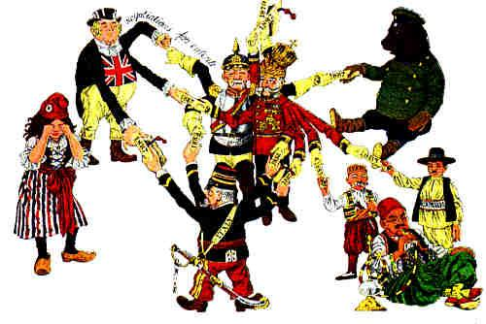
Alliances in Europe
What European alliances existed before WWI?
How did alliances create conflict among European nations?

Slide 2
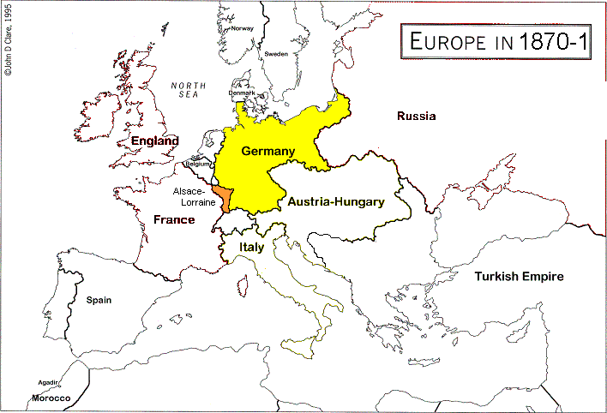
Franco-Prussian War (1870-71)
France was defeated in its war with Germany (Prussia). To secure peace, France had to give the provinces of Alsace-Lorraine to Germany. France was very angry over this and its policy for revanche (revenge) against Germany was more firmly established.
Germany, under Bismarck, wanted to keep France isolated to limit France’s ability to attack Germany. “I don’t like so many Frenchmen in our house who do not want to be there.” (On the annexation of Lorraine)

Slide 3
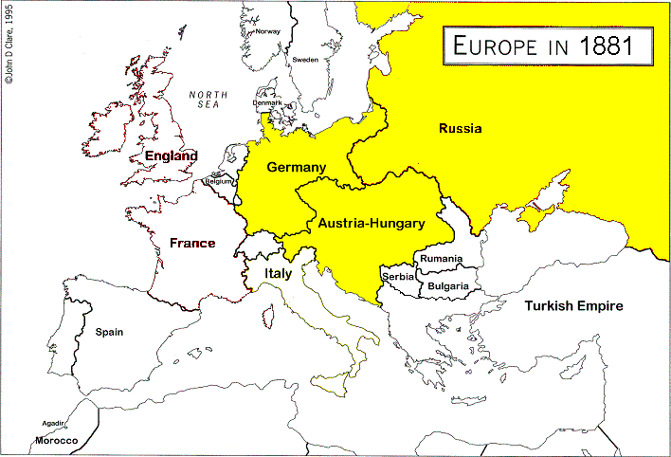
Three Emperors’ League, 1881
In the 1900s, Germany was under the guidance of Chancellor Bismarck. He believed the best way to protect Germany was to maintain good relationships with neighbouring European countries. To achieve this he negotiated several alliances. One was with Austria-Hungary and Russian, the Three Emperors’ League.
This main reason this agreement was negotiated - it protected two of Germany’s borders.

Slide 4
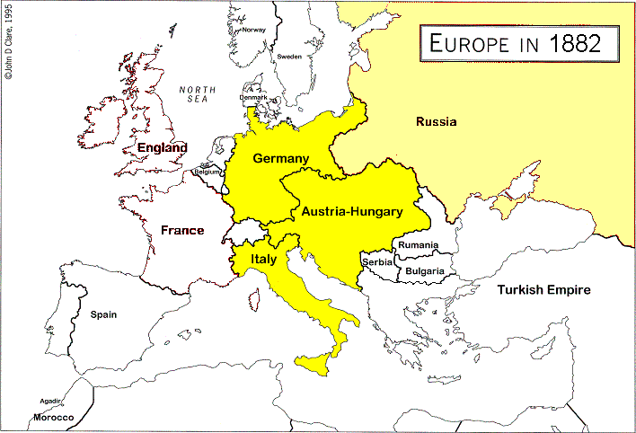
Triple Alliance, 1882
Bismarck also negotiated an alliance that united Italy and Austria-Hungary with Germany. Italy was angry over France’s occupation of Tunisia. It was happy to join the Triple Alliance protect itself from France.
This agreement, as well as the Re-Insurance agreement with Russia further ensured Germany’s safety.

Slide 5
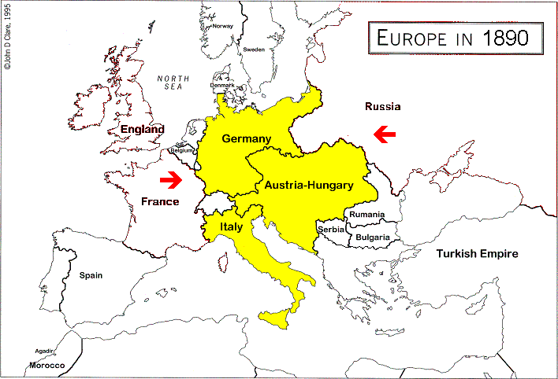
Germany’s Alliances Change
In 1890, Kaiser Wilhelm II fired Bismarck and pursued a different path. He refused to sign the Re-Insurance Treaty with Russia because Russia had signed agreements with Bulgaria and Romania.
Pan-Slavism was in conflict with Pan-Germanism and the territorial expansion plans of Austria-Hungary, Germany’s ally.

Slide 6
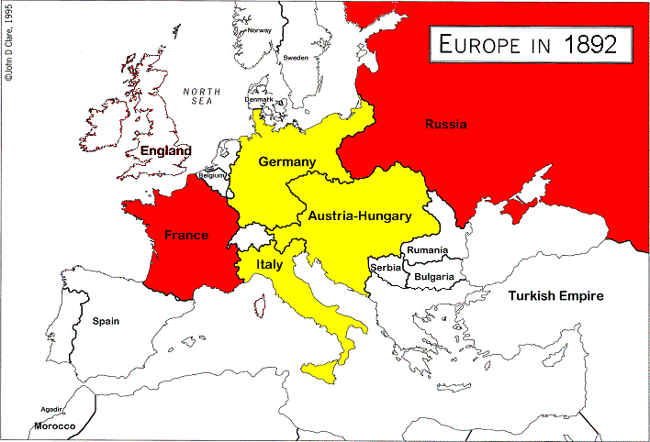
Franco-Russian Alliance, 1892
Russia felt abandoned and threatened. Russia and France signed an alliance treaty in 1892 to protect themselves from the Triple Alliance. The Franco-Russian Alliance was seen as a threat to Germany, however.
The situation Bismarck had worked so hard to prevent was reality - Germany would now have to defend itself on two fronts in any future conflicts!

Slide 7


Anglo-Japanese Naval Agreement, 1902
Imperialism resulted in competition over the resources of China among Russia, Japan and Great Britain. After Japan defeated Russia, it agreed to strengthen its naval agreements with Britain.
Japan and Britain signed the Anglo-Japanese Naval Agreement in 1902. The two powers agreed to remain neutral in any war fought by the other to preserve the status quo and to join the other in any war fought against two powers.
This agreement allowed Britain to focus on protecting itself in the European area, a growing concern because of its arms race with Germany.

Slide 8
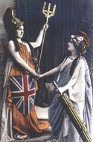
Entente Cordiale, 1904
Britain became increasingly concerned over Germany’s growing military. It had wanted to sign treaties with Germany, but it could not support the actions of Germany’s ally Austria-Hungary. Britain decided to enter an Entente Cordiale (friendly agreement) with France. France and Britain set aside imperialistic rivalry to establish a defensive partnership.
Europe’s two largest military powers were now in opposite camps.

Slide 9
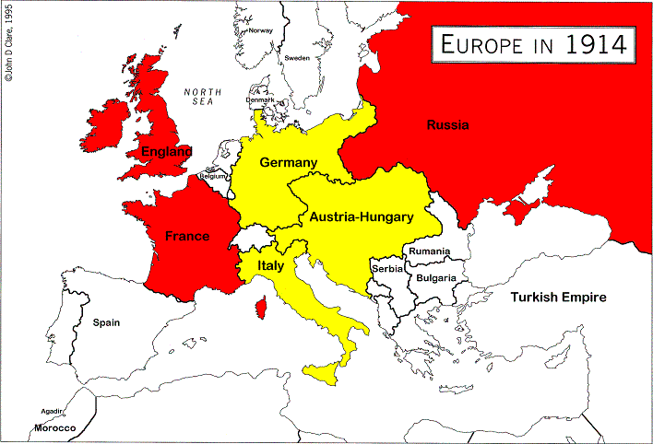
Triple Entente, 1907
Russia signed the Triple Entente with Britain and France to counter the actions of Austria-Hungary (and its ally Germany) in the Balkans.
In 1914, Europe was divided between the Triple Alliance (Germany, Austria-Hungary, Italy) and the Triple Entente (Britain, France, Russia).
Some thought this balance of power would keep any power from aggressive action against another.

Slide 10
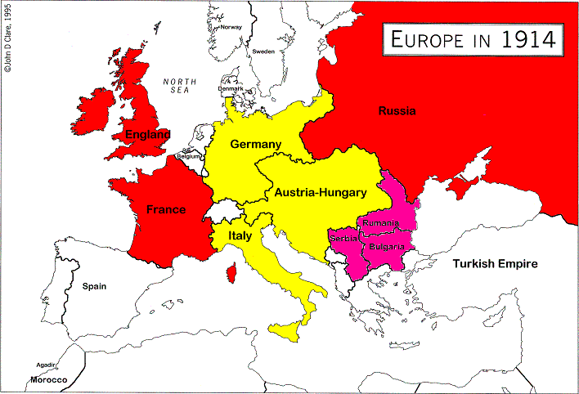
The Balkans
Russia supported the Slav nations of Serbia, Romania and Bulgaria in their desire to be independent Slav nation-states. This policy (Pan-Slavism) was in direct conflict with the national interests of Austria-Hungary.

Slide 11
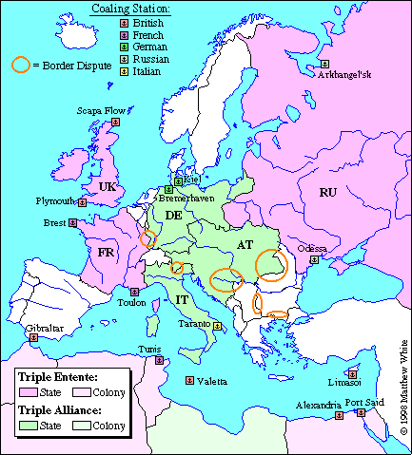
Alliances in 1914
By 1914, the disputes over the Balkans and other borders were increasingly creating conflict between the Triple Alliance and the Triple Entente.

Slide 12
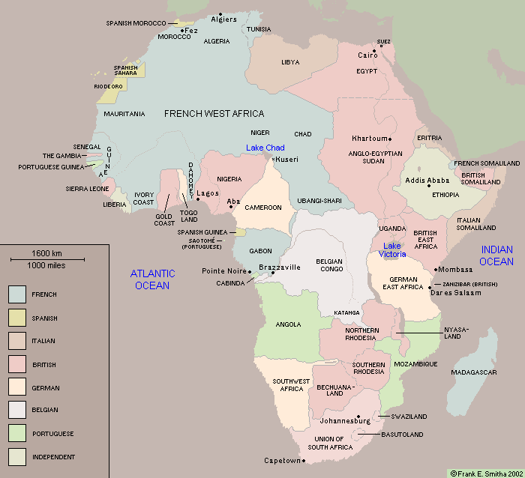
Colonial Map of Africa, 1914
Examine the map closely. What does it tell you about the distribution of
power before WWI?

Slide 13
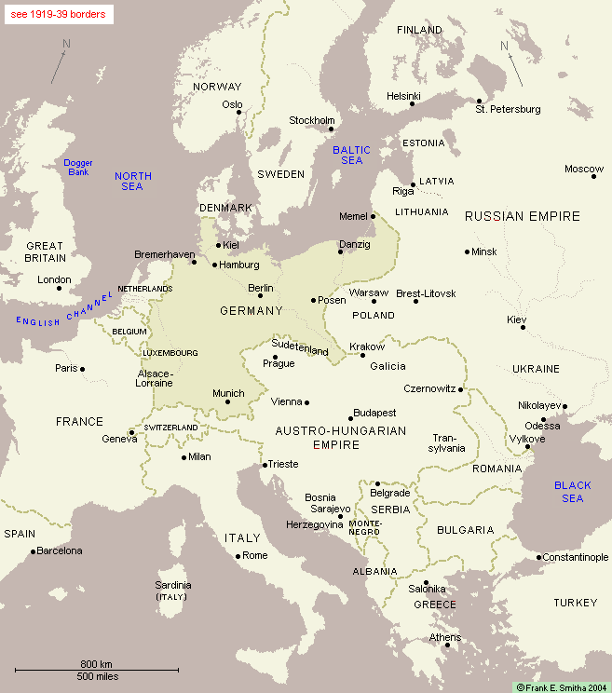
Borders of Europe, 1914
In 1878, the Congress of Berlin divided territories formally under Turkey’s control between Russia and Austria-Hungary. Russia gained the western provinces; Serbia was freed from Turkish rule; and temporary control over Bosnia and Herzegovina was given to Austria-Hungary.
Remember Pan-Slavism? How did this division interfere with that national goal?

Slide 14
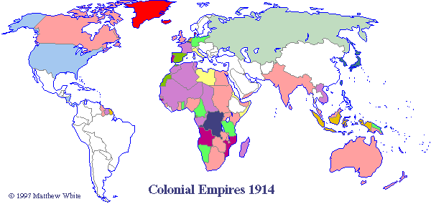
Colonial Map of World, 1914
Colonies were considered allies of the nation that had colonized them. When the mother colony went to war, so did the colony.
What would this mean for Canada?

Slide 15
Summary
Bismarck, in many ways a master strategist of the 19th century warned what would happen after Wilhelm II abandoned the policy of preventive warfare:
"A generation that has taken a beating is always followed by a generation that deals one." (On France)
"Some damned foolish thing in the Balkans," (Prediction on what would provoke the next war)
Another political theorist, Machiavelli, advised statesmen to: … keep your friends close, but your enemies closer.
Alliances made among European nations from 1870-1907 were a big factor in the start of WWI. How might the strategies of Bismarck and Machiavelli have prevented WWI?

